Slide 1
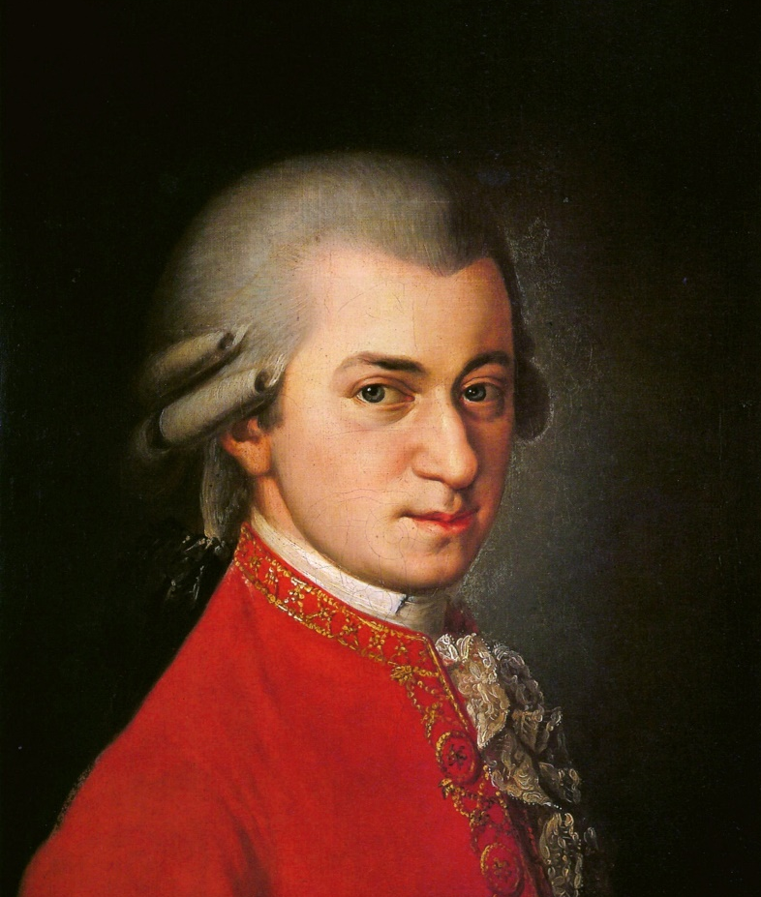
You are listening to…
Overture to the Marriage of Figaro
by Wolfgang Amadeus Mozart
Mozart wrote this as an introduction (overture) to one of his operas.
An opera is a play, but the actors sing everything.
He wrote his first opera at the age of 11!

Slide 2
Landmark: Sydney Opera House and Sydney Harbour Bridge - Australia

Slide 3
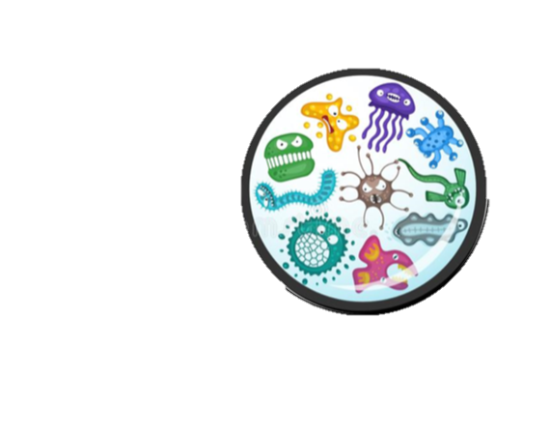
Person: Louis Pasteur – discovered germs
Louis Pasteur is one of the most important scientists in history.
Louis Pasteur proved that germs (such as bacteria and viruses) are living things and make people poorly.
He developed vaccines that make people immune to diseases such as small pox.
Pasteur’s discoveries show the importance of handwashing to stop germs spreading.

Slide 4
Work of Art Mona Lisa by Leonardo Da Vinci
This is the most famous painting in the world.
What words would you use to describe this picture?

Slide 5
You are listening to…
Overture to the Marriage of Figaro
by Wolfgang Amadeus Mozart
Mozart wrote this as an introduction (overture) to one of his operas.
An opera is a play, but the actors sing everything.
He wrote his first opera at the age of 11!

Slide 6
Landmark: Sydney Opera House and Sydney Harbour Bridge - Australia

Slide 7
Person: Louis Pasteur – discovered germs
Louis Pasteur is one of the most important scientists in history.
Louis Pasteur proved that germs (such as bacteria and viruses) are living things and make people poorly.
He developed vaccines that make people immune to diseases such as small pox.
Pasteur’s discoveries show the importance of handwashing to stop germs spreading.

Slide 8
Work of Art Mona Lisa by Leonardo Da Vinci
This is the most famous painting in the world.
What words would you use to describe this picture?

Slide 9
You are listening to…
Overture to the Marriage of Figaro
by Wolfgang Amadeus Mozart
Mozart wrote this as an introduction (overture) to one of his operas.
An opera is a play, but the actors sing everything.
He wrote his first opera at the age of 11!

Slide 10
Landmark: Sydney Opera House and Sydney Harbour Bridge - Australia

Slide 11
Person: Louis Pasteur – discovered germs
Louis Pasteur is one of the most important scientists in history.
Louis Pasteur proved that germs (such as bacteria and viruses) are living things and make people poorly.
He developed vaccines that make people immune to diseases such as small pox.
Pasteur’s discoveries show the importance of handwashing to stop germs spreading.

Slide 12
Work of Art Mona Lisa by Leonardo Da Vinci
This is the most famous painting in the world.
What words would you use to describe this picture?

Slide 13
Person: Louis Pasteur – discovered germs
Louis Pasteur is one of the most important scientists in history.
Louis Pasteur proved that germs (such as bacteria and viruses) are living things and make people poorly.
He developed vaccines that make people immune to diseases such as small pox.
Pasteur’s discoveries show the importance of handwashing to stop germs spreading.

