Slide 1
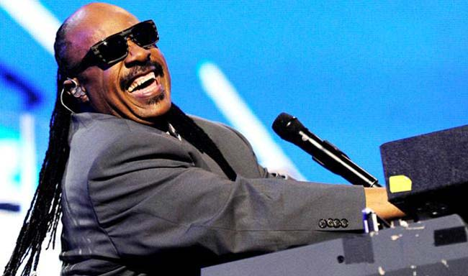
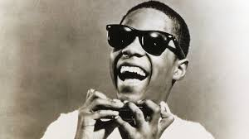
You are listening to…
Stevie Wonder is a pop musician from America.
He has been blind his whole life.
Living for the City
by Stevie Wonder

Slide 2
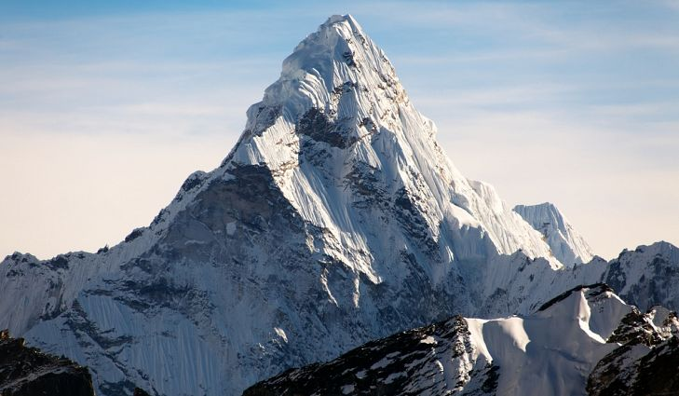
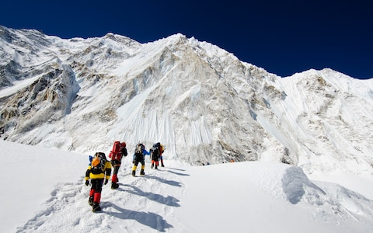
Landmark: Mount Everest- China and Nepal
Notes:
World’s highest mountain.

Slide 3
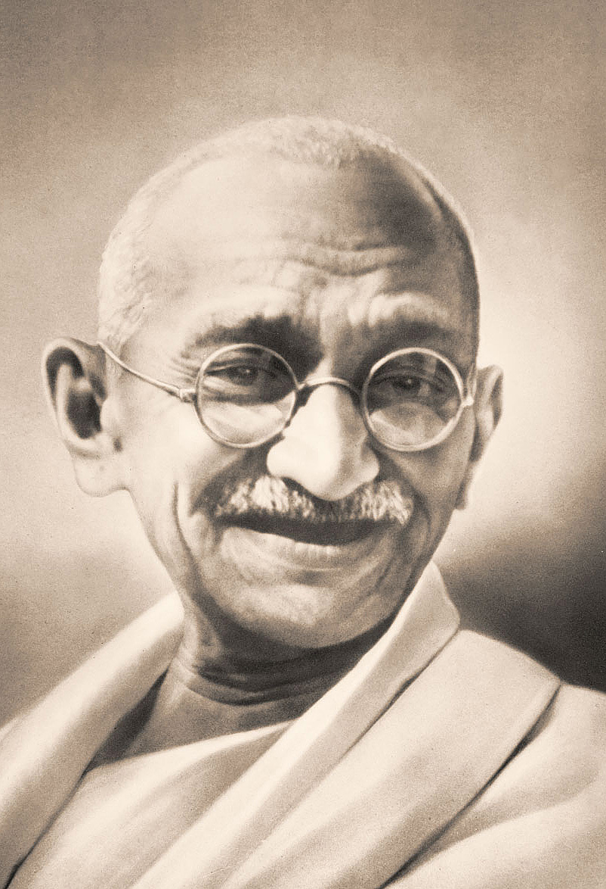
Person: Gandhi – Indian political leader
Gandhi is famous for working to achieve freedom and equality for all in India and South Africa.
Ghandi was a man of peace: he liberated India from British rule by entirely non-violent means.
Gandhi is known as Mahatma meaning ‘Great Soul’.

Slide 4
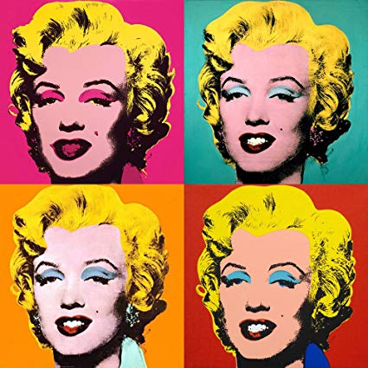
Work of Art Marilyn by Andy Warhol
Warhol was fascinated by famous people whose pictures were everywhere.
The lady in this picture, Marilyn Monroe, was the world’s most famous actress in the 1950s.
He used stencils and printing techniques to reproduce images many times.
Who is the lady in the picture?
Why do you think the image is repeated in different ways?

Slide 5
You are listening to…
Stevie Wonder is a pop musician from America.
He has been blind his whole life.
Living for the City
by Stevie Wonder

Slide 6
Landmark: Mount Everest- China and Nepal
Notes:
World’s highest mountain.

Slide 7
Person: Gandhi – Indian political leader
Gandhi is famous for working to achieve freedom and equality for all in India and South Africa.
Ghandi was a man of peace: he liberated India from British rule by entirely non-violent means.
Gandhi is known as Mahatma meaning ‘Great Soul’.

Slide 8
Work of Art Marilyn by Andy Warhol
Warhol was fascinated by famous people whose pictures were everywhere.
The lady in this picture, Marilyn Monroe, was the world’s most famous actress in the 1950s.
He used stencils and printing techniques to reproduce images many times.
Who is the lady in the picture?
Why do you think the image is repeated in different ways?

Slide 9
You are listening to…
Stevie Wonder is a pop musician from America.
He has been blind his whole life.
Living for the City
by Stevie Wonder

Slide 10
Landmark: Mount Everest- China and Nepal
Notes:
World’s highest mountain.

Slide 11
Person: Gandhi – Indian political leader
Gandhi is famous for working to achieve freedom and equality for all in India and South Africa.
Ghandi was a man of peace: he liberated India from British rule by entirely non-violent means.
Gandhi is known as Mahatma meaning ‘Great Soul’.

Slide 12
Work of Art Marilyn by Andy Warhol
Warhol was fascinated by famous people whose pictures were everywhere.
The lady in this picture, Marilyn Monroe, was the world’s most famous actress in the 1950s.
He used stencils and printing techniques to reproduce images many times.
Who is the lady in the picture?
Why do you think the image is repeated in different ways?

Slide 13
You are listening to…
Stevie Wonder is a pop musician from America.
He has been blind his whole life.
Living for the City
by Stevie Wonder

Slide 14
Landmark: Mount Everest- China and Nepal
Notes:
World’s highest mountain.

Slide 15
Person: Gandhi – Indian political leader
Gandhi is famous for working to achieve freedom and equality for all in India and South Africa.
Ghandi was a man of peace: he liberated India from British rule by entirely non-violent means.
Gandhi is known as Mahatma meaning ‘Great Soul’.

Slide 16
Work of Art Marilyn by Andy Warhol
Warhol was fascinated by famous people whose pictures were everywhere.
The lady in this picture, Marilyn Monroe, was the world’s most famous actress in the 1950s.
He used stencils and printing techniques to reproduce images many times.
Who is the lady in the picture?
Why do you think the image is repeated in different ways?

Slide 17
Person: Gandhi – Indian political leader
Gandhi is famous for working to achieve freedom and equality for all in India and South Africa.
Ghandi was a man of peace: he liberated India from British rule by entirely non-violent means.
Gandhi is known as Mahatma meaning ‘Great Soul’.

Slide 18
Work of Art Marilyn by Andy Warhol
Warhol was fascinated by famous people whose pictures were everywhere.
The lady in this picture, Marilyn Monroe, was the world’s most famous actress in the 1950s.
He used stencils and printing techniques to reproduce images many times.
Who is the lady in the picture?
Why do you think the image is repeated in different ways?

