Slide 1
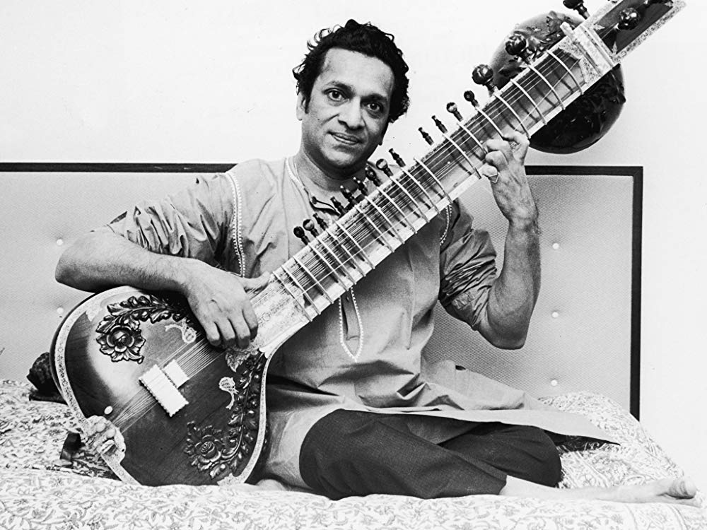
You are listening to…
Ragas
by Ravi Shankar
Ravi Shankar was an Indian musician.
He played the sitar, a plucked string instrument.
This music is improvised – Ravi is making it up as he goes along!

Slide 2
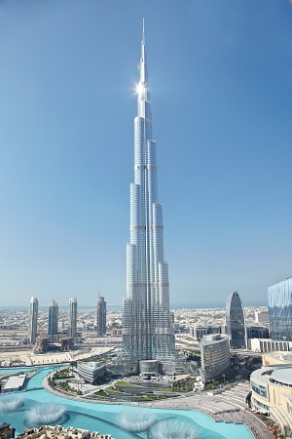
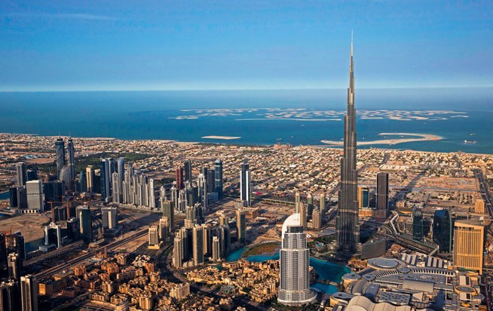
Landmark: Burj Khalifa - Dubai
The tallest building in the world: 828 metres!
Notes:
World’s tallest building.

Slide 3
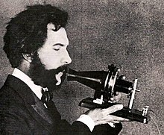
Person: Alexander Graham Bell – invented the telephone
Alexander Graham Bell was a Scottish-born scientist, inventor and engineer.
He invented the telephone in 1876.
He made the first phone call ever. He said to his assistant, “Mr Watson, come here.”
He moved to America to teach speech to deaf students.

Slide 4
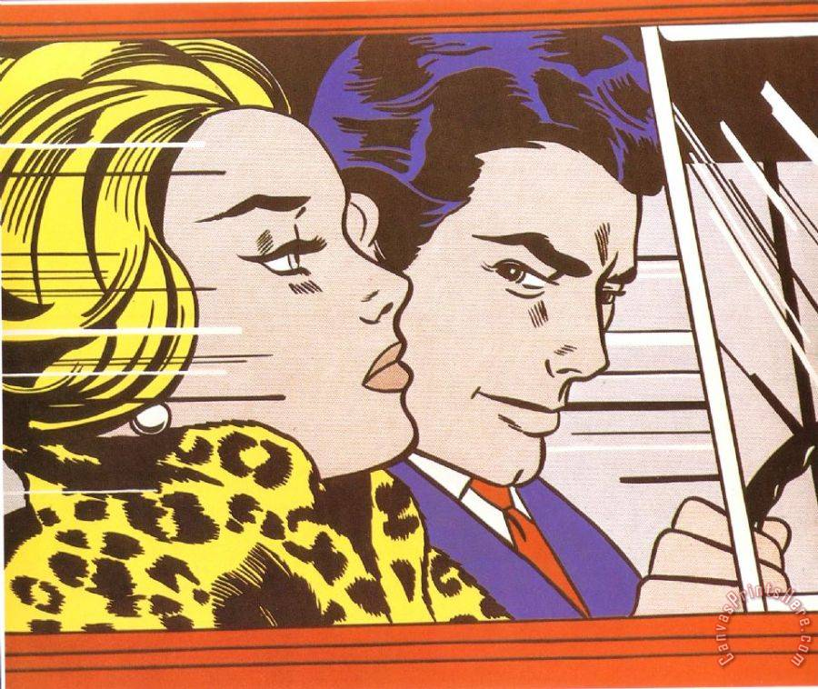
Work of Art In the car by Lichtenstein
This is an example of Pop Art.
What might they be thinking?
Where do you think they are going?
Notes:
Pop Art (same as Andy Warhol)

